Slide 1



Assignment5_Team1
View in Power BI
Last data refresh:
7/15/2018 9:24:43 PM Atlantic Standard Time
Downloaded at:
7/15/2018 9:30:00 PM Atlantic Standard Time

Slide 2
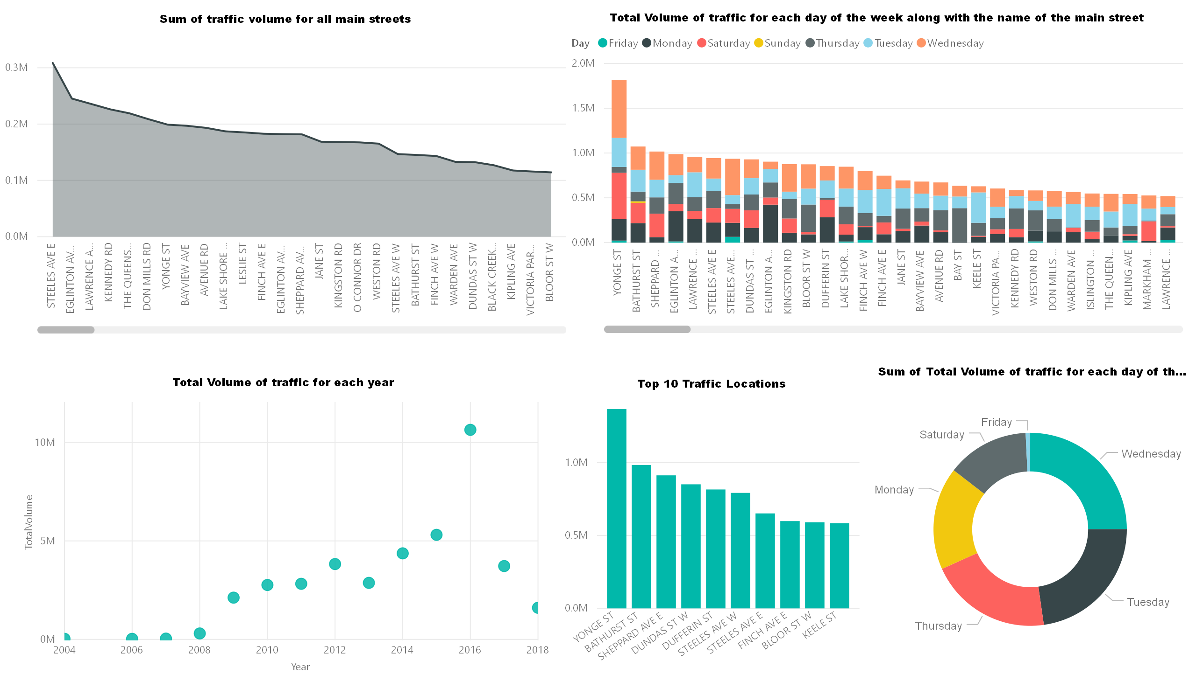

Slide 3
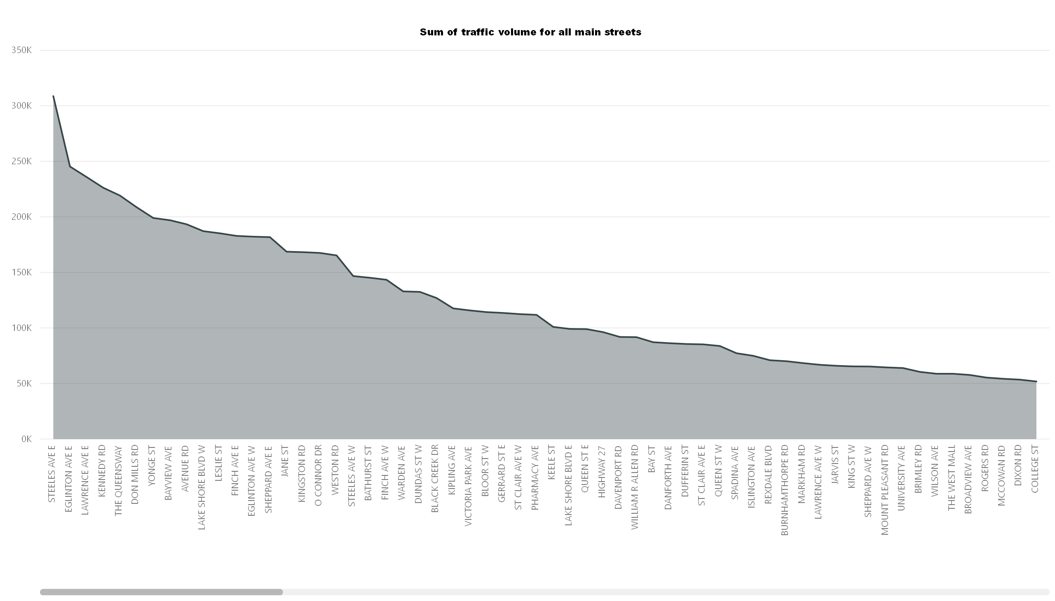

Slide 4
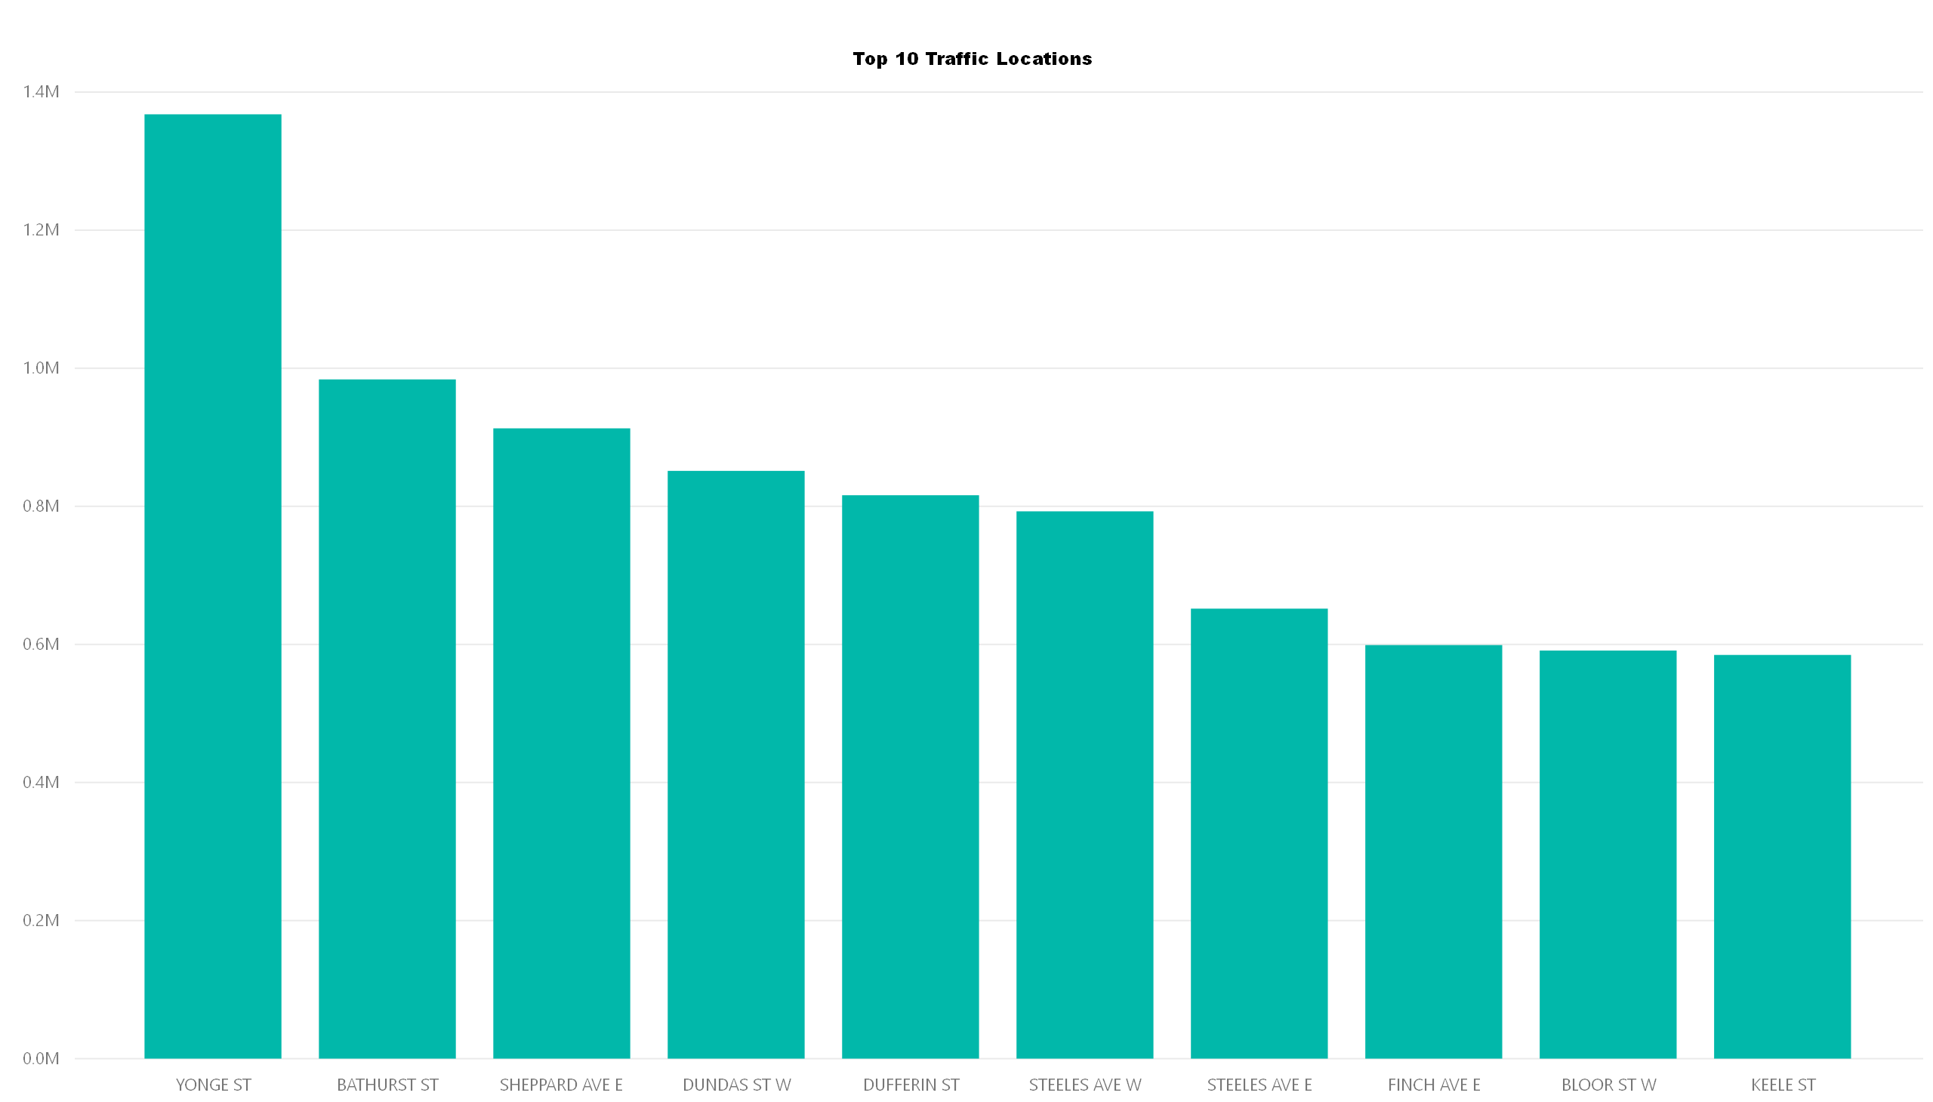

Slide 5
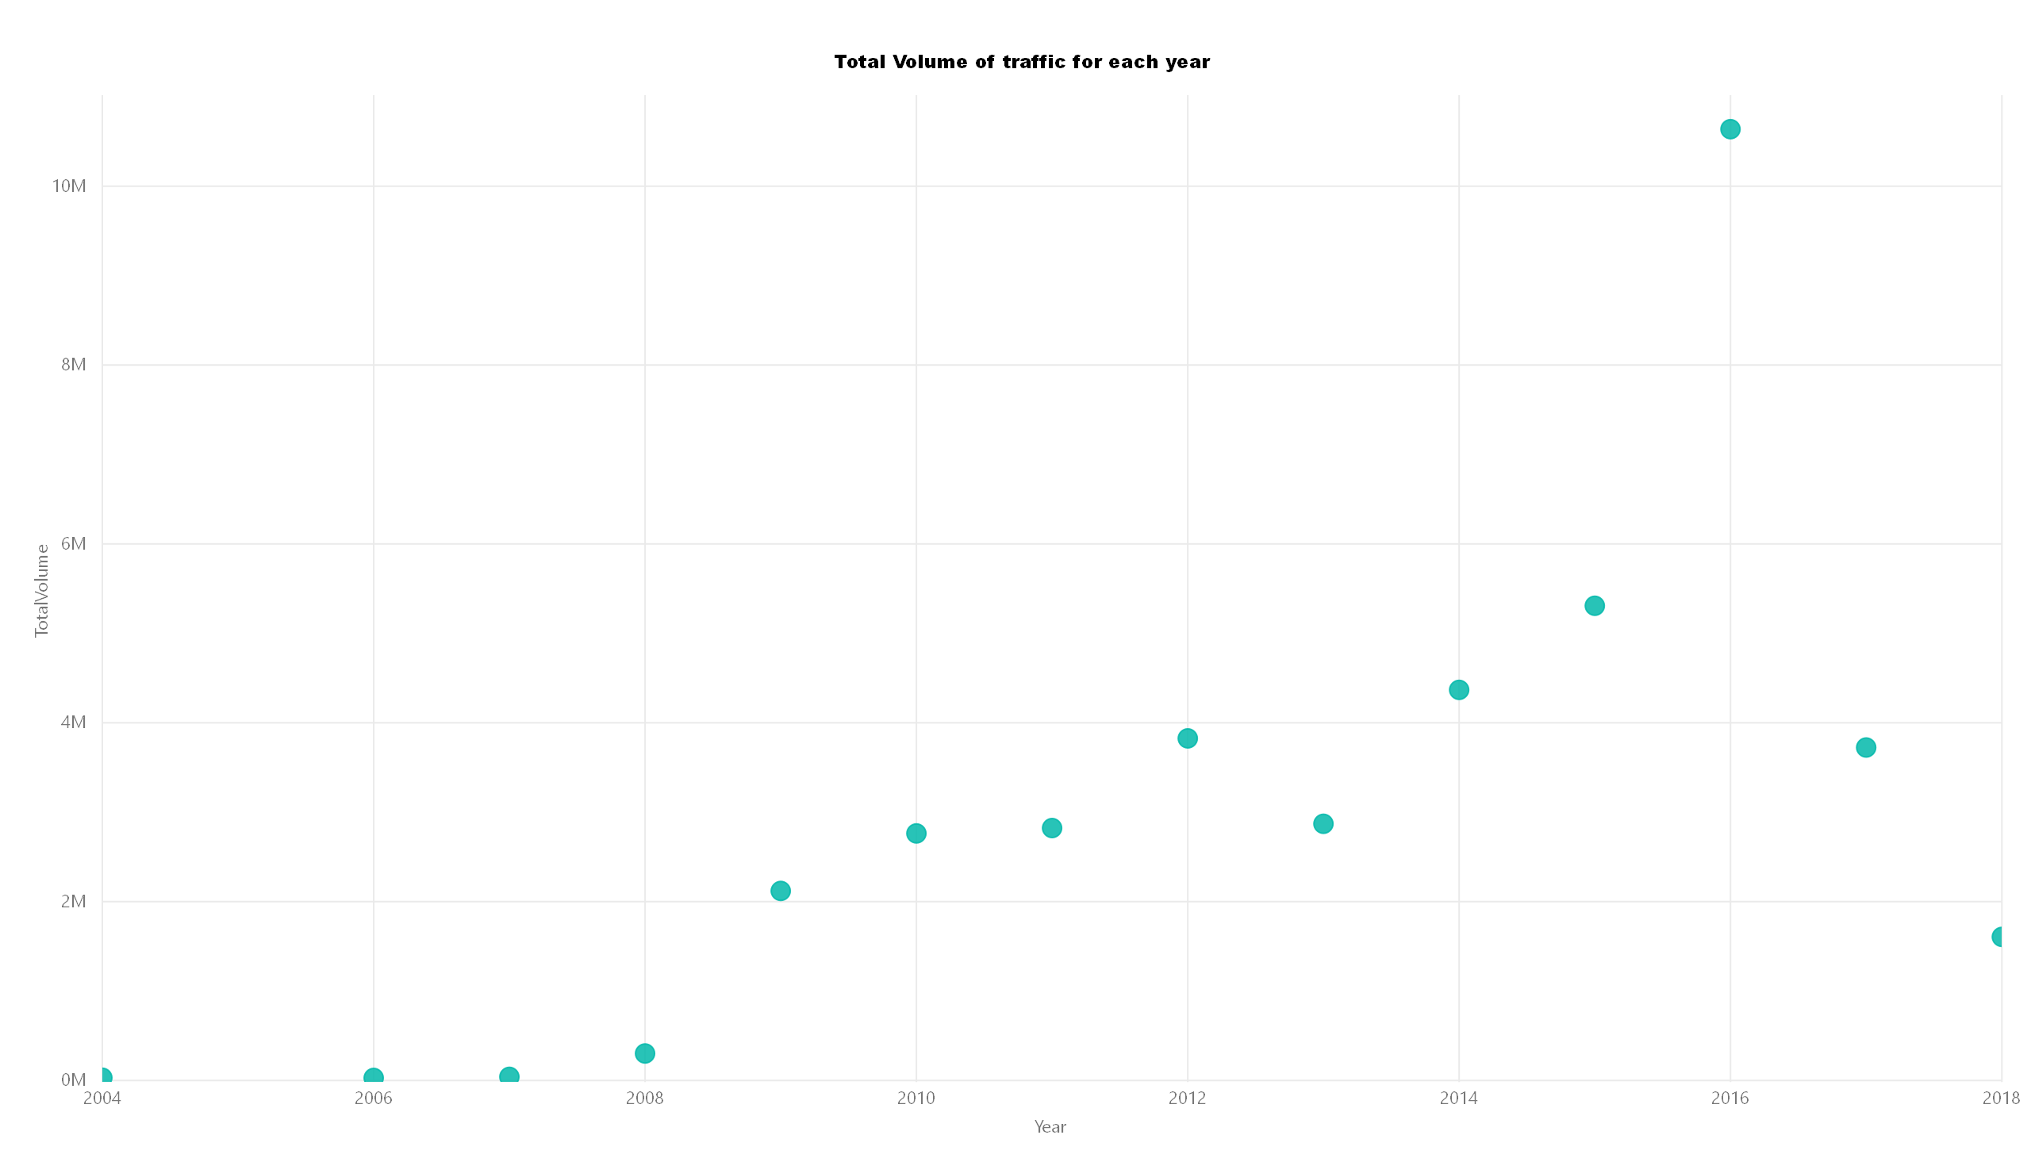

Slide 6
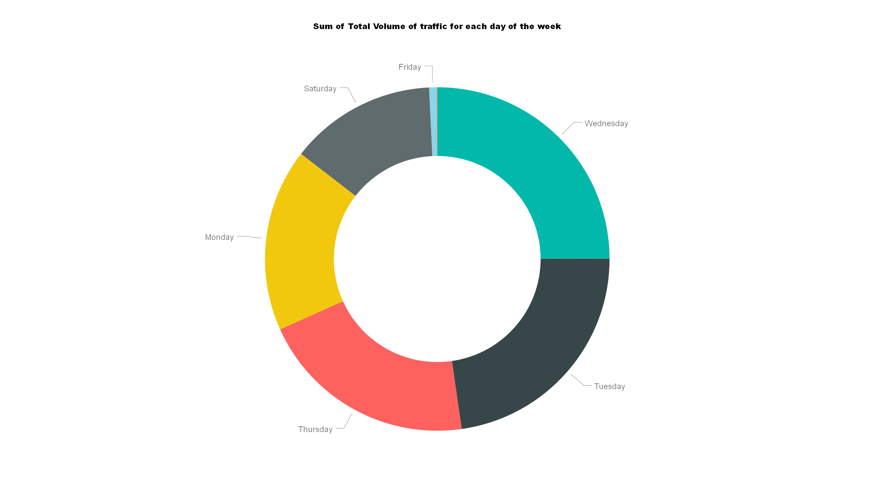

Slide 7
